Slide 1
Conditional Statements
Tim Smith, Fiona Tiffanie Schwallie

Slide 2
Overview
The core competency that we have chosen this week is Conditional Statements. Here we will learn more about the IF statements as well as,

Slide 3
If Statements
The condition in SQL IF Statement should return a Boolean value to evaluate
We can specify a SELECT statement as well in a Boolean expression, but it should enclose in parentheses
We can use BEGIN and END in the IF Statement to identify a statement block
The ELSE condition is optional use

Slide 4
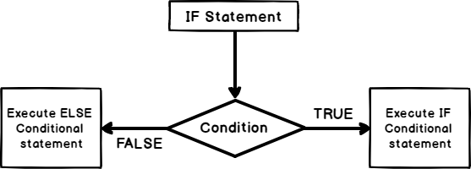
IF Statements examples
Flow Chart
Code Example
1 2 3 4 5 6 7 8 9 10 11 | DECLARE @StudentMarks INT= 70; IF @StudentMarks >= 90 BEGIN PRINT 'Congratulations, You are in Merit list!!'; Print 'Second statement.' END; ELSE BEGIN PRINT 'Failed,Try again '; Print 'Second ELSE statement' END;

Slide 5
user-defined scalar SUBtypes
A subtype is a data type that is a subset of another data type, which is its base type.
The STRING and VARCHAR data types are subtypes of the VARCHAR2 data type. They both have the same value range as the VARCHAR2 base type. Assignments between variables of these subtypes are implicitly converted, provided the variables have the same size.
Subtypes inherit the behavior of a data type but also typically have constrained behaviors. An unconstrained subtype doesn’t change a base type’s behavior, they are also called aliases. You can call any base data type a supertype, because it is the model for subtypes. Unconstrained subtypes are interchangeable with their base types, while only qualified values can be assigned to constrained subtypes from base types.

Slide 6
user-defined scalar SUBtypes
DATE Data Type
Interval Subtypes
TIMESTAMP Subtypes
The DATE data type in Oracle contains an actual timestamp of activity. The valid range is any date from January 1, 4712 BCE (Before Common Era) to December 31, 9999 CE (Common Era). The most common way to capture a timestamp is to assign the SYSDATE or SYSTIMESTAMP built-in function. They both return fully qualified dates and contain all field elements of a DATE variable or column.
You have two DATE subtypes available that let you manage intervals:
INTERVAL DAY TO SECOND and INTERVAL YEAR TO MONTH.
Their prototypes are:
INTERVAL DAY[(leading_precision)] TO SECOND[(fractional_second_precision)] INTERVAL YEAR[(precision)] TO MONTH
It extends the DATE base type by providing a more precise time. You’ll get the same results if the TIMESTAMP variable is populated by calling the SYSDATE built-in function.
The SYSTIMESTAMP SQL built-in function provides a more precise time for most platforms.

Slide 7
SUMMARY
With the use of conditional statements. They have the power to help ease programming data to extract or see the data that we are wanting at that specific time.

Slide 8
References
IF Statements: https://www.sqlshack.com/sql-if-statement-introduction-and-overview/
*Fiona’s topic*:

Slide 9
THANK YOU
Tim Smith
Fiona Tiffanie Schwallie

